Slide 2
Building beautiful Blazor apps with Tailwind CSS
Chris Sainty

Slide 3
Building beautiful Blazor apps with Tailwind CSS
Chris Sainty

Slide 4


Hi, I’m Chris… 👋
👨‍💻 Software Engineer @ Enable
🏆 Microsoft MVP
💻 Blogger: chrissainty.com
📗 Author: Blazor in Action
🔧 Open Source...r?: Blazored

Slide 5
What is Tailwind CSS?

Slide 6


is a utility based CSS framework

Slide 7
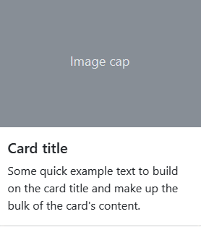

Slide 8
<div class="card">
<img class="card-img-top">
<div class="card-body">
<h5 class="card-title">...</h5>
<p class="card-text">...</p>
</div>
</div>

Slide 9
<div class="flex flex-col">
<img class="rounded-t h-40">
<div class="p-4 text-gray-800">
<h5 class="text-lg font-semibold mb-2">...</h5>
<p class="text-base">...</p>
</div>
</div>

Slide 10
is one big design system

Slide 11
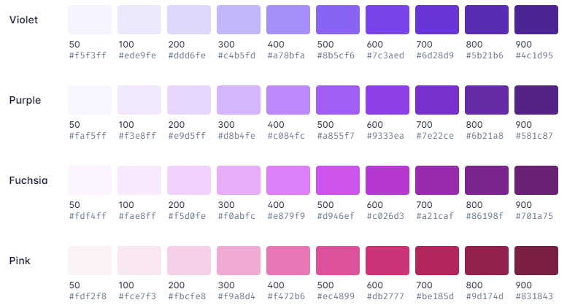
Colour Palette

Slide 12
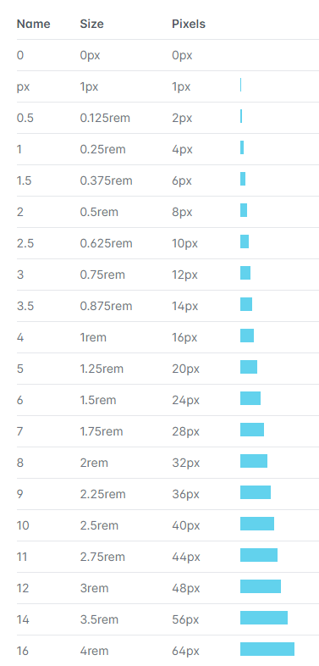
Spacing

Slide 13
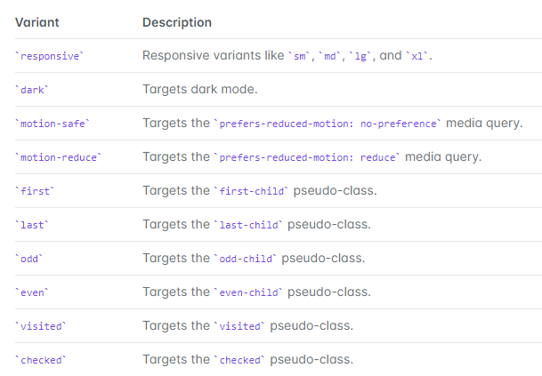
Variants

Slide 14
All this stuff is configurable
module.exports = {
theme: {
colors: {
blazorpurple: '#7019db',
blue: '#1fb6ff',
pink: '#ff49db',
orange: '#ff7849',
green: '#13ce66',
yellow: '#ffc82c',
gray-dark: '#273444',
gray: '#8492a6',
gray-light: '#d3dce6'
}
}
}

Slide 15

Utility classes are Lego blocks for UI design

Slide 16
Adding Tailwind to a Blazor project – Option 1
Using the Tailwind Play CDN

Slide 17
Tailwind via CDN
<!doctype html>
<html>
<head>
<meta charset="UTF-8" />
<meta name="viewport" content="width=device-width, initial-scale=1.0" />
<script src="https://cdn.tailwindcss.com"></script>
</head>
<body>
<!-- ... -->
</body>
</html>

Slide 18
Tailwind via CDN
<!doctype html>
<html>
<head>
<meta charset="UTF-8" />
<meta name="viewport" content="width=device-width, initial-scale=1.0" />
<script src="https://cdn.tailwindcss.com"></script>
</head>
<body>
<h1 class="text-2xl font-semibold">Tailwind via CDN</h1>
</body>
</html>

Slide 19
Adding Tailwind to a Blazor project – Option 2
Using the Tailwind CLI

Slide 20
Demo

Slide 21
Thank you for watching

